Slide 1
Vowpal Wabbit
Class Presentation
-Team-9
Bhavesh Patel
Ila Nigam
Ayushi Srivastava

Slide 2
What is Machine Learning?
In a nutshell:
The process of a computer (self) learning from data
Two types of learning:
  Supervised: learning from labeled (answered) examples
  Unsupervised: no labels, e.g. clustering

Slide 3
Vowpal Wabbit Facts
Written in C/C++
Linux, Mac OS-X, Windows
Both a library & command-line utility
Source & documentation on GitHub + wiki
Growing community of developers & users
https://github.com/JohnLangford/vowpal_wabbit/wiki

Slide 4
Vowpal Wabbit Introduction
The Vowpal Wabbit (VW) project is a fast out-of-core learning system sponsored by Microsoft Research and (previously) Yahoo! Research.
Developed by John Langford
Fast, highly scalable, flexible, online learner
Open source and Free (BSD License)
  Vorpal (adj): deadly
  (Created by Lewis Carroll to describe a sword)
  Rabbit (noun): mammal associated with speed

Slide 5
Fast, scalable, flexible, online learner?
Fast
Learn a Tera-feature (10¹²) data-set on 1000 nodes in one hour
Scalable
Out-of-core online learning: no need to load all data into memory
The hashing trick: feature identities are converted to a weight index via a hash
Exploiting multi-core CPUs: parsing of input and learning are done in separate threads.
Flexible
The input format for the learning algorithm is substantially more flexible (Free form text)
Online Learner
Compute error, Update model (per feature weights)

Slide 6
What can VW do?
Solve several problem types:
Linear regression
Classification (+ multi-class)
using multiple reductions/strategies]
Matrix factorization (SVD like)..
More…..

Slide 7
What sets VW apart?
Automatic optimal handling of “scales”:
No need to normalize feature ranges
Takes care of unimportant vs important features
Adaptive & separate per feature learning rates
Speed and scalability:
Unlimited data-size (online learning)

Slide 8
What sets VW apart?
Hash trick
Feature names are hashed fast
Very flexible input format:
Accepts sparse data-sets, missing data
Can mix numeric, categorical/ boolean features in natural-language
size:6.3 color=blue age<7 is_cool
Over-fit resistant
On-line learning: Compute error, Update model (per feature weights)

Slide 9
Algorithm
There are two ways to have a fast learning algorithm: (a) start with a slow algorithm and speed it up
(b) build an intrinsically fast learning algorithm.
VW uses Loss function algorithm : squared, logistic, hinge and quantile. Squared is for regression, logistic hinge and progressive validation loss for classification, quantile for ranking
VW now supports a few modes of non-linear supervised learning:
    Neural network with a single hidden layer
    Automatic creation of polynomial, specifically quadratic and cubic, features
    N-grams

Slide 10
Demo- Sentiment Analysis on Movie Reviews with Vowpal Wabbit
The Rotten Tomatoes movie review data set is a corpus of movie reviews used for sentiment analysis.
The train and test data sets are tab-separated files with phrases from the Rotten Tomatoes data set

Slide 11
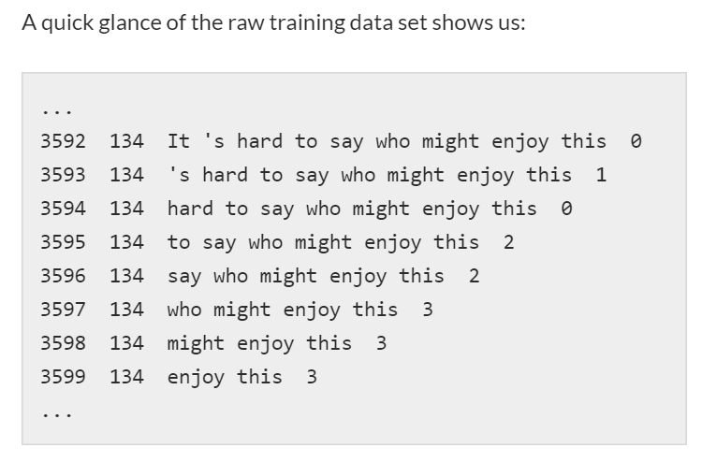
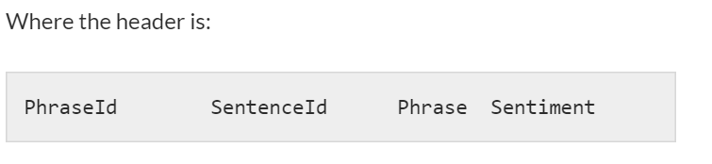

Slide 12
Labels
Every phrase has a label describing the sentiment. The labels are:
0 – negative
1 – somewhat negative
2 – neutral
3 – somewhat positive
4 – positive
To build a model that can classify multiple labels we need a multiclass approach
Vowpal Wabbit can reduce the multiclass problem to as many binary classification problems as there are classes.

Slide 13
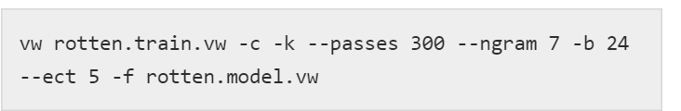
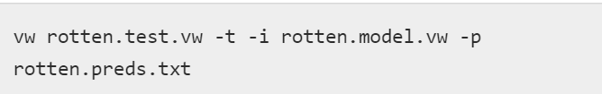
Data Munging & Feature Generation and Creating model
We need to turn the raw data sets into a Vowpal Wabbit-friendly format first.
Python is perfect for data munging.
Model is created with this command
Making Predictions on the Test set

Slide 14
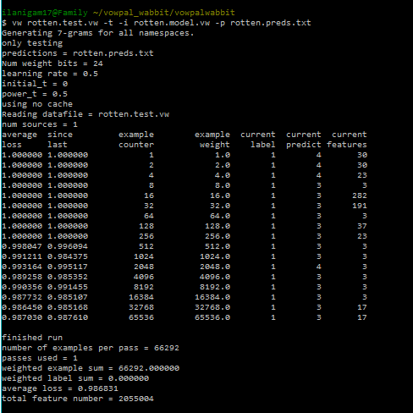

Slide 15
Thank You

